Slide 1
Measuring Small Amounts
Part 1: Using pipets and micropipets

Slide 2
Purpose: to accurately measure liquids
To compare accuracy of measurements when using graduated cylinders and pipets.
To learn techniques of using pipets and micropipets.
To practice using pipets to become accurate.

Slide 3
Measuring using the metric system
What unit are used? What equipment?
Liquid
Mass

Slide 4
Units in the Metric System:
Base | 1 | 10º | 1
Deci- d | 1/10 | 10-¹ | 0.1
Centi- c | 1/100 | 10-² | 0.01
Milli- m | 1/1000 | 10-³ | 0.001
Micro- μ | 1/1,000,000 | 10-⁶ | 0.000001

Slide 5
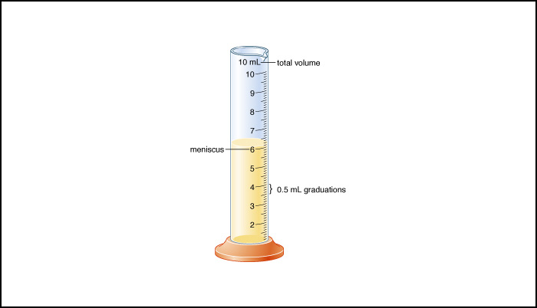
Graduated Cylinder

Slide 6
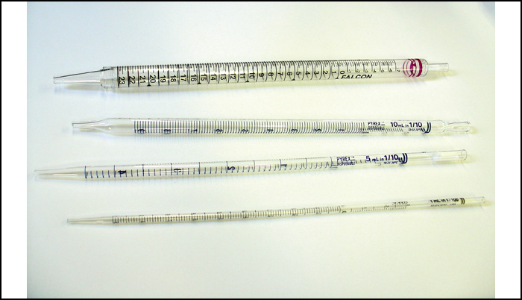
Pipets - Serological

Slide 7
Pipets
What does it measure? Units?
What sizes are available?
What range of amounts can each pipet size be used to measure?
Practice measuring:
1.0 mL 2.6 mL 5.0 mL
7.2 mL 8.4 mL 10.0 mL

Slide 8
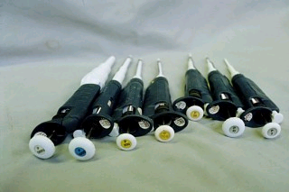
Use and Maintenance of Micro-pipets

Slide 9
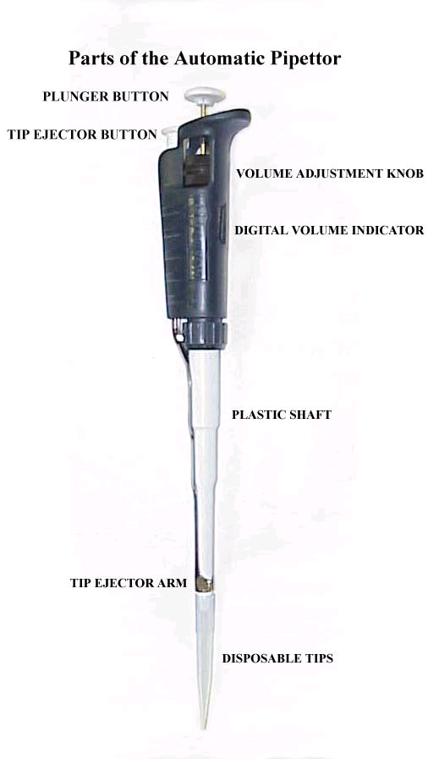
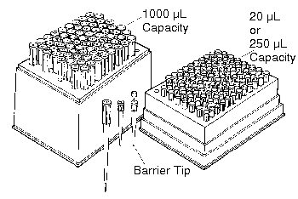
Parts of the Pipette
Pipette tips

Slide 10
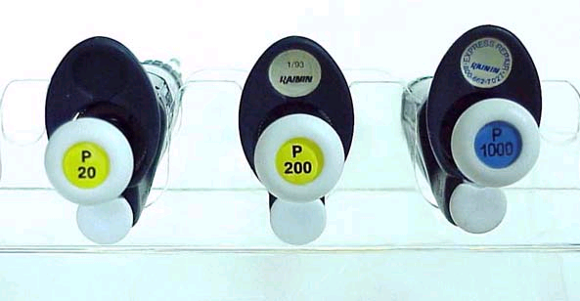
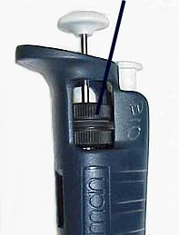
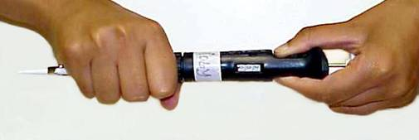
Operating the Micropipette
Step 1: Set the Volume
Volume Adjustment Knob:
Digital Volume Indicator:

Slide 11
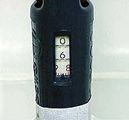
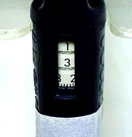
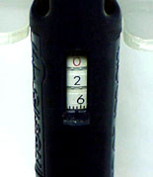
Operating the Micropipet
Step 2: Read the Volume
How to Read the Volume Indicator:
0.5-10 μL Model 6.86 μ l = 0.00686 mL | 10- 200 Model 132.4 μ l = 0.1324 mL | 100 - 1000 Model 262 μ l= 0.262 mL

Slide 12
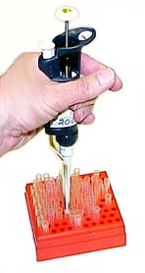
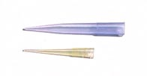
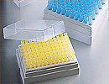
Operating the Micropipet
Step 3: Attach the Disposable Tip
Example of tip sizes:
Attaching the disposable tip

Slide 13
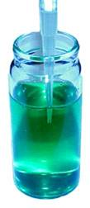
Operating the Micropipette
Step 4: Depress the Plunger to the First Stop
Step 5: Immerse Tip in Sample
To aspirate the sample into the tip, allow the pushbutton to return slowly and smoothly to the fully extended UP POSITION. NEVER LET THE PLUNGER SNAP UP! This draws the exact calibrated volume into the tip if the tip remains below the liquid surface during withdrawal.
Step 6: Draw up the sample
Step 7: Pause
Wait a few seconds to ensure that the full volume of sample is drawn into the plastic tip. WAIT LONGER FOR LARGER VOLUMES. WAIT LONGER FOR MORE VISCOUS ("SYRUP-LIKE") SUBSTANCES.

Slide 14
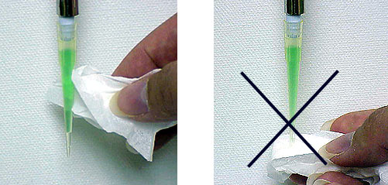
Operating the Micropipet
Remove the tip from the sample liquid. No liquid should remain on the OUTSIDE of the tip. Wipe away any droplets on the outside of the tip with a lint-free tissue, such as KIMWIPES, but only wipe droplets from the side of the tip. NEVER TOUCH THE TIP OPENING or you may absorb part of your sample.
Step 8: Withdraw the Tip
Proper Droplet Removal
WRONG Droplet Removal

Slide 15
Operating the Micropipette
To dispense the sample from the pipette: a) Touch the tip end to the side wall of the receiving vessel and b) Depress the plunger to the FIRST STOP. c) Pause for at least one second--
d) Press the plunger to the SECOND STOP (the second point, of greater resistance,
at the bottom of the stroke) to expel any residual liquid in the tip (like "blowing out" a glass pipette).
Step 9: Dispense the Sample
(a) Start Dispensing | (b) 1st Stop = Dispense | (c) 2nd Stop = Expel

Slide 16
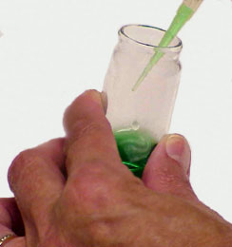
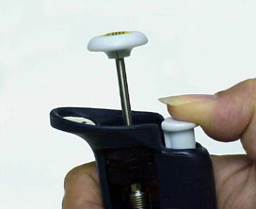
Operating the Micropipette
Step 9: Withdraw the Pipette
With the plunger fully depressed, withdraw the pipet from the receiving vessel carefully, sliding the tip along the wall of the vessel. Holding the tip against the side of vessel is especially important when transferring small volumes of liquid.
Step 10: Release the Plunger
Gently allow the plunger to return to the UP position. DO NOT allow it to SPRING BACK!
Step 11:Discard the Tip
A fresh tip should be used for each sample to prevent sample carryover.
iscard the tip by depressing the tip ejector button, as
Press ejector button to discard tip.

Slide 17
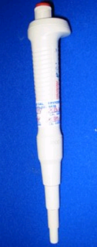
Step-wise Operation of the Automatic Pipette
(1) Set the volume
(2) Attach disposable tip
(3) Depress the plunger to the first stop
(4) Immerse tip in sample
(5) Draw up the sample
(6) Pause
(7) Withdraw the tip
(8) Dispense the sample
(9) Withdraw the pipette
(10) Release plunger
(11) Discard the tip
Notes:
As you read the following steps, you should manipulate the automatic pipette,
disposable tips, and the vials of colored solution TO LEARN HOW TO PROPERLY
HANDLE THE PIPETS.
STEP-WISE OPERATION OF THE AUTOMATIC PIPET
As you read the following steps, you should manipulate the automatic pipette,
disposable tips, and the vials of colored solution TO LEARN HOW TO PROPERLY
HANDLE THE PIPETS.
1) SET THE VOLUME: Hold the pipet in one hand while turning the volume
adjustment knob until the correct volume shows on the digital indicator.
Proper Grasp to Set Volume
Turn 1/3 revolution above the desired setting and then slowly down to the
desired setting for optimal accuracy.
2) ATTACH DISPOSABLE TIP: Press disposable tip of PROPER SIZE firmly to the
shaft of the pipet to ensure a positive airtight seal.
Tip Sizes Attaching Tip
3) DEPRESS THE PLUNGER TO THE FIRST STOP: Using your thumb, depress the plunger
gently and smoothly until resistance is felt. The point of resistance is the
first stop. It is that part of the stroke that extends the piston to the
calibrated volume which is displayed on the digital indicator.
Depress Plunger 1st Stop
4) IMMERSION INTO THE SAMPLE: With the pipet in a vertical position, immerse the
disposable tip into the sample liquid to a depth of at least 3-4 mm
(millimeters) below the liquid surface for the common pipets,
Immerse Tip in Sample
5) DRAW UP THE SAMPLE: To aspirate the sample into the tip, allow the pushbutton
to return slowly and smoothly to the fully extended UP POSITION. NEVER LET THE
PLUNGER SNAP UP! This draws the exact calibrated volume into the tip if the tip
remains below the liquid surface during withdrawal.
6) PAUSE: Wait a few seconds to ensure that the full volume of sample is drawn
into the plastic tip. WAIT LONGER FOR LARGER VOLUMES. WAIT LONGER FOR MORE
VISCOUS ("SYRUP-LIKE") SUBSTANCES.
7) WITHDRAW THE TIP: Remove the tip from the sample liquid. No liquid should
remain on the OUTSIDE of the tip. Wipe away any droplets on the outside of the
tip with a lint-free tissue, such as KIMWIPES, but only wipe droplets from the
side of the tip. NEVER TOUCH THE TIP ORIFICE (opening) or you may absorb part of
your sample.
8) DISPENSE THE SAMPLE: To dispense the sample from the pipet,
a) Touch the tip end to the side wall of the receiving vessel and
b) Depress the plunger to the FIRST STOP.
c) Pause for at least one second-- or longer for viscous liquids.
d) Press the plunger to the SECOND STOP (the second point, of greater
resistance, at the bottom of the stroke) to expel any residual liquid in the tip
(like "blowing out" a glass pipet).
9) WITHDRAW THE PIPET: With the plunger fully depressed, withdraw the pipet from
the receiving vessel carefully, sliding the tip along the wall of the vessel.
Holding the tip against the side of vessel is especially important when
transferring small volumes of liquid.
10) RELEASE PLUNGER: Gently allow the plunger to return to the UP position. DO
NOT allow it to SPRING BACK!
11) DISCARD THE TIP: Discard the tip by depressing the tip ejector button,
A fresh tip should be used for each sample to prevent sample carryover.
n handling the automatic pipettors. Also, be certain that you can
BOTH READ AND SET THE PROPER VOLUMES.
PIPETTING CONSIDERATIONS
Accuracy and Precision: Accuracy means the closeness with which the dispensed
volume approximates the volume set on the pipette. It is specified as mean
error, the average deviation of replicate measurements from the expected set
volume. Precision is the "scatter" or reproducibility of individual measurements
of the same volume. It can also be expressed as standard deviation.
Specifications are generally tighter for precision than for accuracy; and, in
controlled experiments, the smaller precision specification is a good estimate
of pipetting accuracy. The smaller the mean error and/or standard deviation of a
measurement, the more accurate and/or precise it is.
TO SUMMARIZE, relative accuracies are generally about 1% or less and precision
is less than 0.5 % except when transferring the smallest recommended volume for
a given pipet model. Us

Slide 18
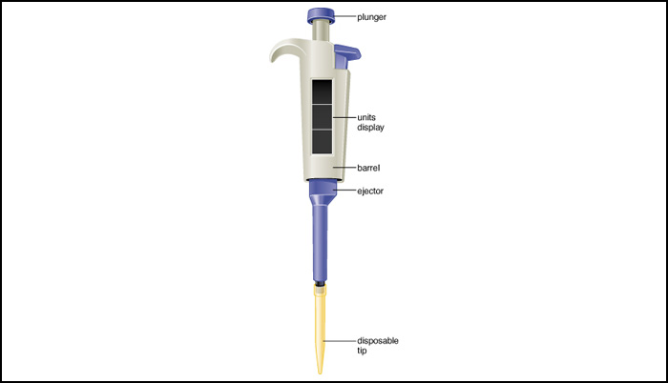
Measuring very small volumes: Micropipet, measuring μL

Slide 19
Lab practice- Micropipet
a. Dial the micropipet to the listed amount in microliters (µL).
b. Place 1 drop of each amount on a piece of Parafilm. Check to determine if the size of the drops are the same. Repeat 3 times.
c. Determine the mass of the drop using the digital balance. Record your data. Repeat 3 times,
Volume to pipet: 1.8 µL; 80 µL; 200 µL, 1000 µL

